Slide 1


GloboDiet interview steps
INTERNATIONAL AGENCY FOR RESEARCH ON CANCER LYON - FRANCE
e-SMP

Slide 2

Access to menus and functions
Prior to the interview
Three interview modes
GloboDiet interview steps
  General information
  Quick list (QL)
  Description and quantification (D/Q)
  Overall controls
  Dietary supplements
  End of interview
  Some GloboDiet Features
Interview steps
IARC, Lyon - France
GloboDiet training:

Slide 3


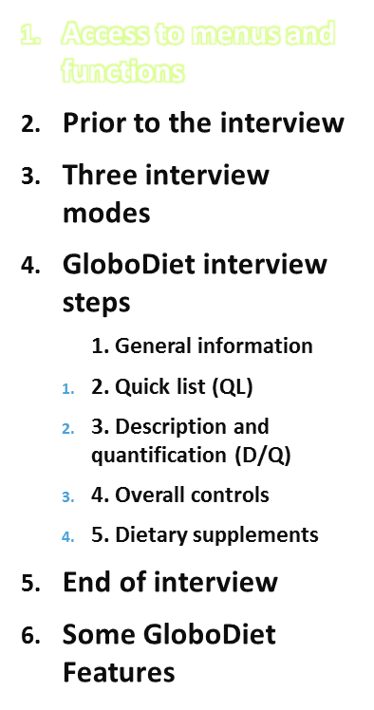
All the information presented now are in the GloboDiet user manual.
Appendix 2: Summary of functions of the GloboDiet application
  Hot keys at the bottom of the screen and in menus
  Right click of the mouse to access the available functions (menu)
  In a list, type the first letter(s) to access a descriptor/string
Interview steps
IARC, Lyon - France
GloboDiet training:

Slide 4
Access to menus and functions
Mouse (moving cursor, click, double click)
Scroll arrows
Function keys (F1, F2, … )
Ctrl-key/Alt-key in combination with a letter
Interview steps
IARC, Lyon - France
GloboDiet training:

Slide 5
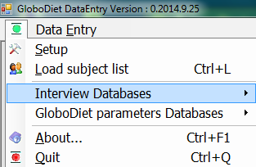
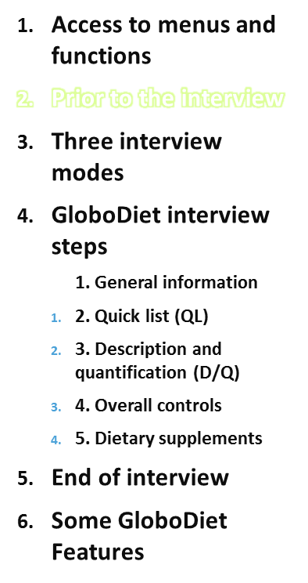
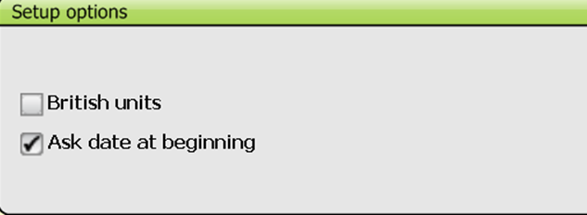
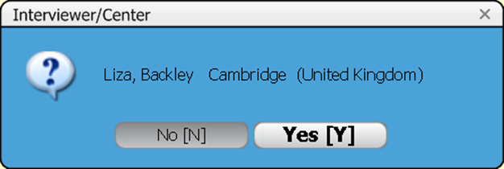
A list of subjects to be interviewed may be loaded → select the Excel file by browsing
British units may be selected in the Setup options
Selection of the country/center
Selection of the interviewer
Interview steps
IARC, Lyon - France
GloboDiet training:

Slide 6
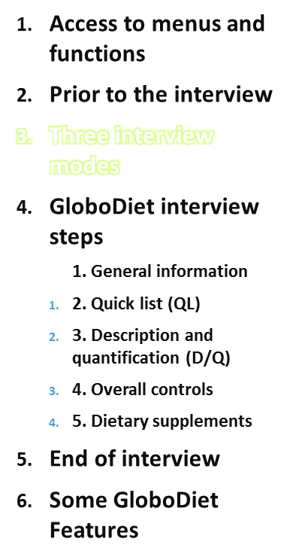
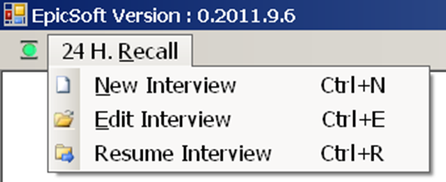
New Interview:
To start a new interview
Resume Interview:
To open an on-going interview (which has not been saved by the interviewer)
Edit Interview:
To open a saved interview, e.g. to amend it.
GloboDiet does not behave exactly as in New interview mode (F2 TIME not active, no QL check screen, all the recipes are updatable)
Interview steps
IARC, Lyon - France
GloboDiet training:

Slide 7
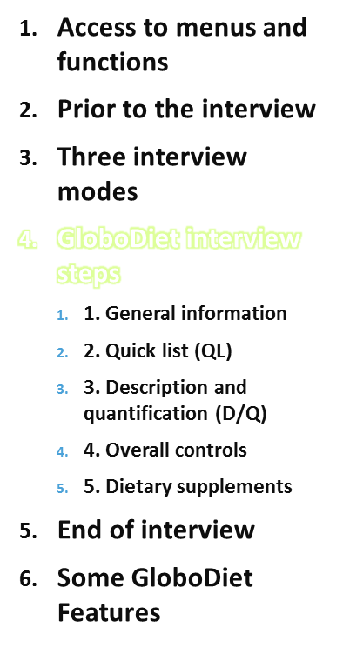
General information
Quick list (QL)
Description and quantification (D/Q)
Overall controls
Dietary supplements
Interview steps
IARC, Lyon - France
GloboDiet training:

Slide 8
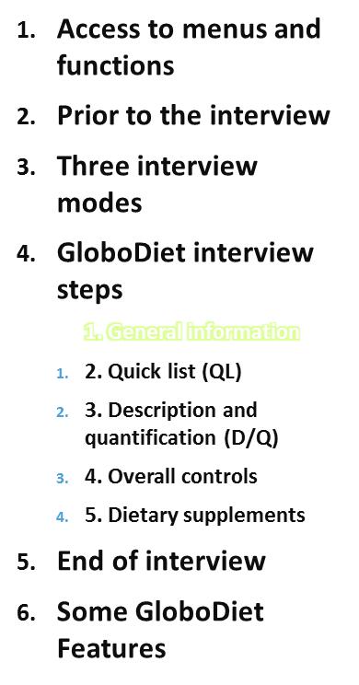
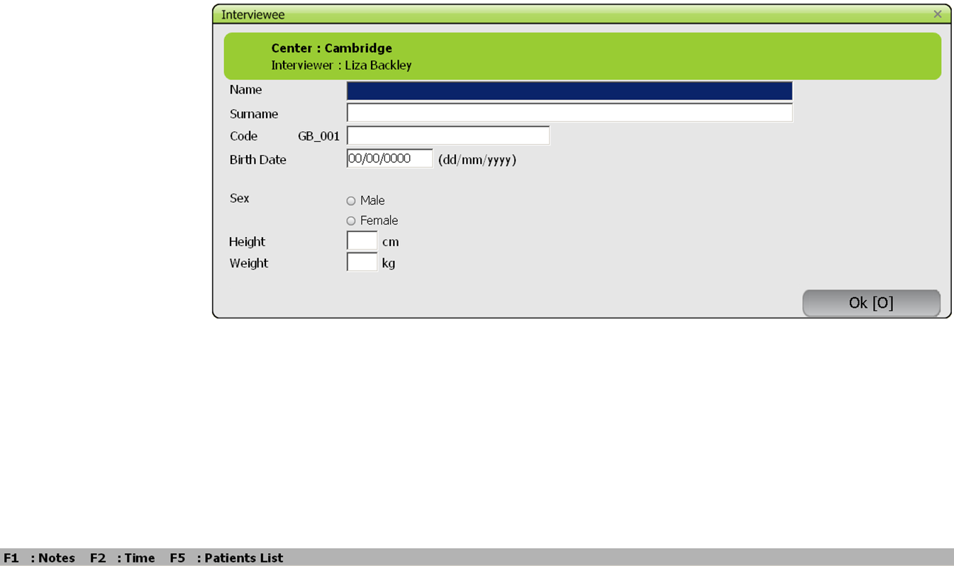
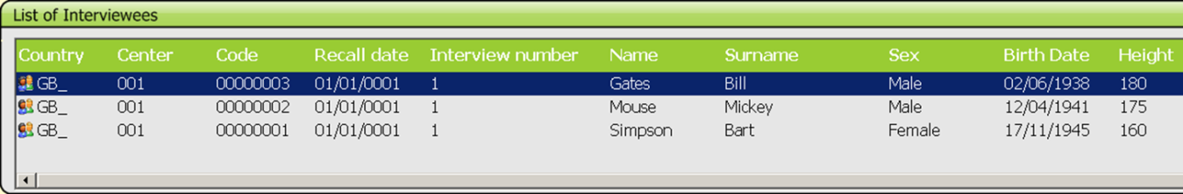
1. General Information
On the subject/interviewee
Be aware that this information may be available in a database (SUBJECTS)
Interview steps
IARC, Lyon - France
GloboDiet training:

Slide 9
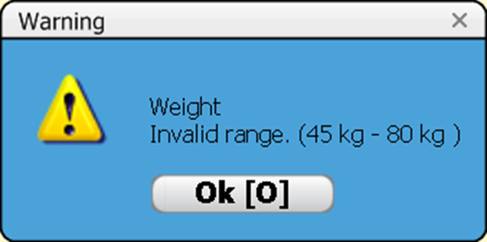
General Information
On the subject/interviewee
Specific instructions – defined at country or project level: handling of interviewee names and surnames (anonymous) ?
Weight and height asked together, to not stress on weight…
There are warnings for date of birth, weight and height (ANTHROP)
Interview steps
IARC, Lyon - France
GloboDiet training:

Slide 10
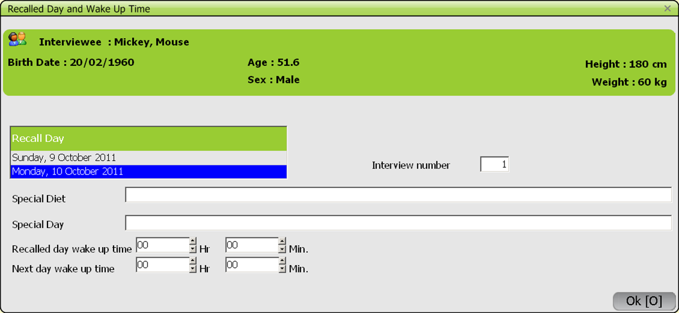
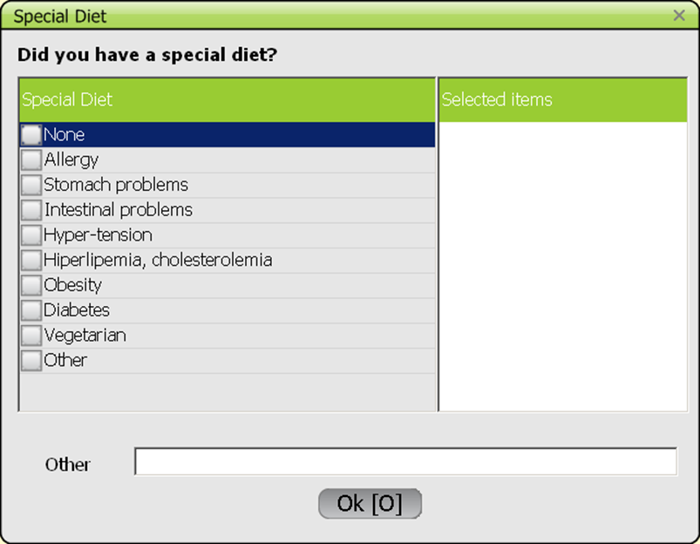
General Information
On the recall day
Interview steps
IARC, Lyon - France
GloboDiet training:

Slide 11
General Information
On the recall day (summary)
Information on the interviewee is recalled on top
  Choose the recalled day from the two options
  Choose from the predefined lists at least
    one special diet (SPECDIET): this is in fact the usual diet (e.g. vegetarian, energy restricted) → ‘do you follow a special diet?’
    one special day (SPECDAY), e.g. on travel, sickness
      ‘None’ means nothing special
      Possibility to enter several choices
      Possibility to specify what other option
  Enter the wake up time of the recalled day and that of the following day
  Note: times are in hours-minutes or only in hours, depending on the project/country setting (PARAM)
Interview steps
IARC, Lyon - France
GloboDiet training:

Slide 12
Practise
Select a New interview – several ways to do it
Select your country, (center), an interviewer name
Enter the interviewee names, code, birth date, sex, height and weight - enter out-of-range birth date (not born or out of the study range), enter out-of-range height and weight
Select a recall day, special day and diet
Enter the wake up times of the successive days
Interview steps
IARC, Lyon - France
GloboDiet training:

Slide 13
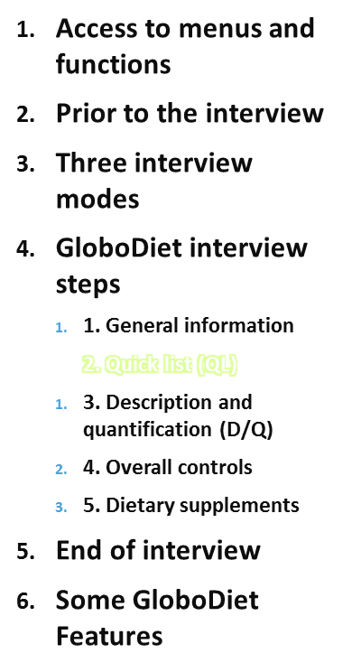
2. Quick list (QL)
Important step: chronological recall process using cognitive approach
  Food consumption occasion (FCO): WHAT MEAL?
  Time of consumption: WHEN?
  Place of consumption (POC): WHERE?
→ Do not rush the interviewee
Rapidly note all reported foods leaving out details & quantification
      The quick list is an open list!
Must know how to handle reported items: food, recipe, composed recipe? (explained later)
Use names as available in the food/recipe list (e.g. ‘Juice, apple’, not ‘Apple juice’)
Skip fats, sauces and sweeteners (will be recalled using probing questions in the D/Q step (FDPROBING))
Interview steps
IARC, Lyon - France
GloboDiet training:

Slide 14
Quick List
Food consumption occasions (FCO):
Example (defined at each project level)
  Before Breakfast (Wake Up)
  Breakfast
  During the Morning
  Before Lunch (Aperitif)
  Lunch
  After Lunch
  During Afternoon
  Before Dinner (Aperitif)
  Dinner
  After Dinner (Digestif)
  During the Evening / At Night
  N.B.: occasions in red may be selected several times (FCO)
Interview steps
IARC, Lyon - France
GloboDiet training:

Slide 15
Quick List
Places of consumption (POC):
Example (defined at each project level)
  Home: own
  Work place/school: at desk, play ground…
  Family/friends
  Self-service/catering: includes canteen
  Fast food restaurant: McDo-type (without cutlery)
  Bar/café/coffee shop/pub: mainly for drinks, simple dish bread-based
  Other restaurant/hotel: self-service, with waiters, buffet: incl. in bakeries, sport accommodation
  Travelling (car/train/plane/boat)
  Outside (street/park/beach): in open air
  Other: enter in the notes more information
Interview steps
IARC, Lyon - France
GloboDiet training:

Slide 16
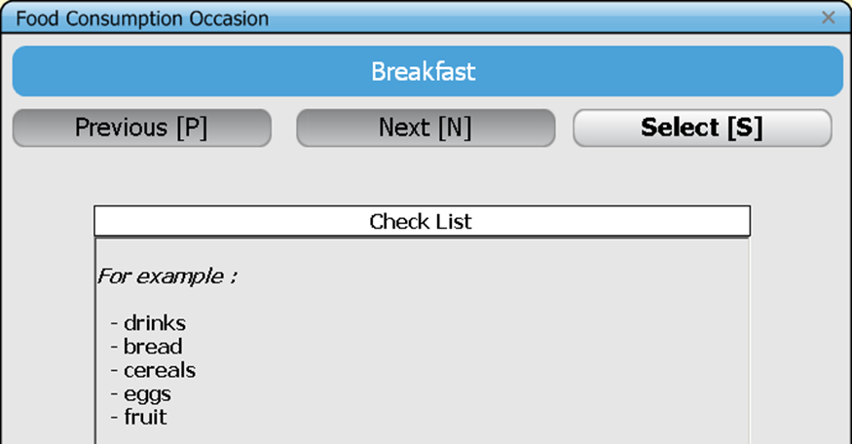
Quick List
Available controls:
Check list (CHECKLIST): for each food consumption occasion/meal, a list of local foods usually consumed at that occasion enables the interviewer to check the list of already reported items.
To be used as a help only in order to not introduce bias:
avoid ‘did you have bread?’ without context but fine when e.g.
‘cheese’ has been reported or if the
subject said he/she liked bread...
rather say ‘Did you have anything
with/after/before it?
Did you add anything?’
in a neutral way
(see interview techniques)
Interview steps
IARC, Lyon - France
GloboDiet training:

Slide 17
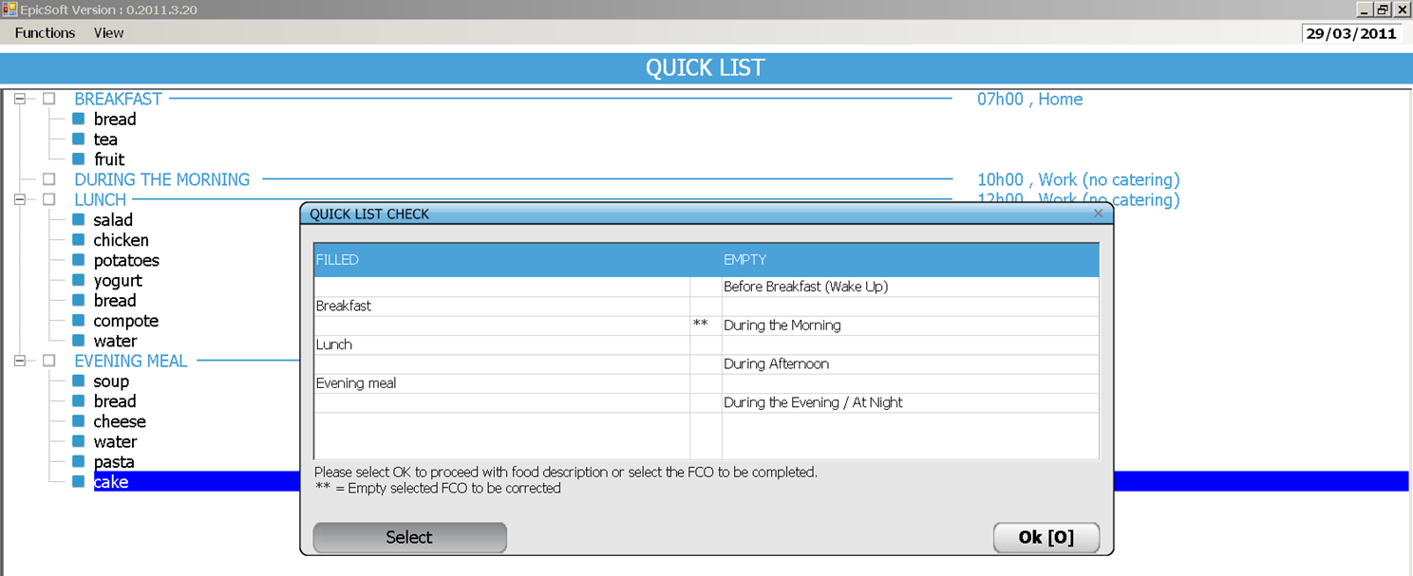
Quick List
Available controls:
When the QL step is finished (‘exit’ option has been chosen), a summary screen appears. Empty FCO(s) highlighted in final screen (**) should be removed from the Quick list or filled in.
Interview steps
IARC, Lyon - France
GloboDiet training:

Slide 18
Practise
Select ‘breakfast’ – eaten at home, 8:00
Enter the quick list items ‘bread’ and ‘tea’
Select ‘during the morning’ – eaten at work, 10:00
Enter the quick list items ‘milk with chocolate’
Select ‘during the morning’ – eaten at work, 11:00
Enter the quick list items ‘apple’
Select ‘lunch’ – eaten at work, 13:00
Enter the quick list items ‘chicken with rice’ and ‘cake’
Dietary supplement ‘Yes’ – vitamin C before breakfast
Select ‘exit from the quick list’
GloboDiet training
IARC, Lyon - France

Slide 19
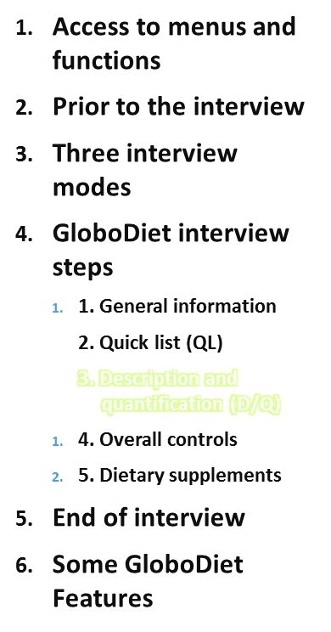
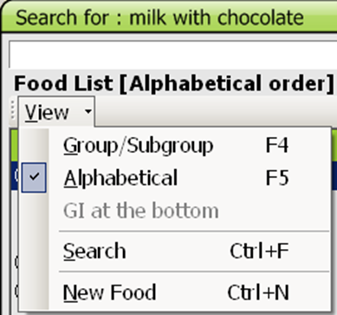
Search the item
Know how to deal with it depending on the information that the subject is able to provide
e.g. ‘milk with chocolate’ may be:
A food item: use ‘milk beverage’, describe as flavoured with chocolate, sweetened,… brand X and quantify
A composed recipe: list ‘milk’, ‘chocolate powder’, describe and quantify each
A mixed recipe: check substitutable ingredients. If OPEN recipe, ingredients may be added and deleted.
Use the alphabetical,
by group or
by string search
in either the food or recipe list.
Interview steps
IARC, Lyon - France
GloboDiet training:

Slide 20
Practise
Fill in the quick list item ‘milk with chocolate’
Use your local version to test what is possible
Test the search functions
  alphabetical
  by group
  on a string (e.g. ‘milk’)
GloboDiet training
IARC, Lyon - France

Slide 21
Search the item
Generic food items or foods not specified (food names ending by n.s.) can be chosen when the respondent cannot describe the specific food item (e.g. The respondent does not remember the type of bread)
If the respondent is able to describe the food item sufficiently, but the item is not included in the food list, then the interviewer needs to create a NEW food item.
Note that NEW foods/recipes are created only for the on-going interview. If relevant for other interviews, they need to be added to the GloboDiet databases to be available for all.
Study specific recommendations to search food items can be agreed upon but need to be discussed with IARC to reassure the concept of standardization (e.g. In Netherlands it is agreed that cow milk is selected when the respondent does not specify the animal source or described it as normal milk)
Interview steps
IARC, Lyon - France
GloboDiet training:

Slide 22
Description
All reported items (food, recipe, ingredients, dietary supplement) are described in GloboDiet
Depending on the item classification and its on-the-fly description, several facets and descriptors are proposed (FADEBYGROUP, FACETRULE, DESC_IMP).
Facets are questions to be asked to the interviewee
Multiple choice is possible for food facets
Example (defined at each project level)
  Source: e.g. sausage made with ‘pork’ and ‘beef’
  Preservation method: e.g. fish, ‘marinated’ and ‘chilled/refrigerated’
  Flavouring agent/Characteristic ingredient: e.g. ice cream, ‘vanilla’ and ‘coffee’; fruit pie with ‘apple, pear, apricot’
and for recipe facets
Interview steps
IARC, Lyon - France
GloboDiet training:

Slide 23
Description
Descriptors are possible answers to the facets.
Depending on the facets, the list of descriptors
  Is predefined at the project level
  Is taken from the local food list (‘Type of fat used’, ‘Type of liquid used’)
  Is a local list which can be completed during the interview (‘Brand name’)
  A default descriptor might have been defined to speed up the interview
  An ‘undefined’ descriptor is always available in case the answer is not known
  Generic descriptors might be available (e.g. ‘cooked with fat’) in case the subject cannot provide more specific information such as whether ‘baked with fat’ or ‘shallow fried/pan fried’.
  Always try to get the most specific/precise answer
Interview steps
IARC, Lyon - France
GloboDiet training:

Slide 24
Description of Foods
Facet ‘Physical state’ as estimated/quantified is important as it guides the choice of some variables (density, max, nutritional values) and of the quantification methods (FDQMDETAIL).
The descriptor ‘flesh’ is the default, standing for ‘whole or in pieces, regular’ (not for fish)
Examples (defined at each project level)
  Milk powder as Milk ‘powdered’ → quantify the powder only
  Boiled potatoes, potato rosti, fish fingers as ‘flesh’
  Custard made from powder as Custard ‘reconstituted from powder’
  Reminder: do not use ‘mashed’ for ingredients.
Interview steps
IARC, Lyon - France
GloboDiet training:

Slide 25
Description of Foods
Facet ‘Food preparation/production’ is needed for food safety issues. It helps discriminate between a food made at home and a food purchased outside home, independently of where it was consumed (POC).
A homemade food made from a commercial mixture is considered as ‘commercial’ to capture the product name and brand.
Interview steps
IARC, Lyon - France
GloboDiet training:

Slide 26
Description of Foods
Facet ‘Fat content’ describes the intrinsic fat content.
We do not expect subject know the exact percentage. ‘whole’ refers to the regular fat content, ‘fat reduced’ to the light version of e.g. cheese, cream. More specific descriptors are available for e.g. milk.
Facet ‘Sugar content’ describes the intrinsic sweetening agent contained in the item.
‘Sweetened n.s.’ means the item tasted sweet and ‘light n.s.’ means the item tasted sweet but not as normal (e.g. rather the taste of artificial sweeteners). More specific information may be captured with specific descriptors.
Interview steps
IARC, Lyon - France
GloboDiet training:

Slide 27
Description of Foods
Facet ‘Preservation method’ refers to what is known by the subject, not to the actual industrial process, e.g. taramasalata will be perceived as ‘chilled’, not as ‘salted’ or ‘smoked’.
‘Fresh’ means which underwent no treatment to preserve (translation issue)
Processed foods which should be stored in the fridge will be described as ‘chilled’, not ‘fresh’.
Raw milk from the farm will be described as ‘fresh’. Refrigerated milk from shop is ‘pasteurised’.
Fresh fruits, vegetables, meat and fish cuts will be described as ‘fresh’ (default for those food groups).
Interview steps
IARC, Lyon - France
GloboDiet training:

Slide 28
Description of Foods
Facet ‘Packing medium’ is asked depending on the answer to the facet ‘Preservation method’.
Pear ‘canned in syrup’ is assumed to have been drained; if some syrup was consumed, it must be listed, described & quantified separately.
Facet ‘Type of packaging’ does not include packaging used for transport but that used for storing, it will capture the material (glass, metal, plastic…)
Interview steps
IARC, Lyon - France
GloboDiet training:

Slide 29
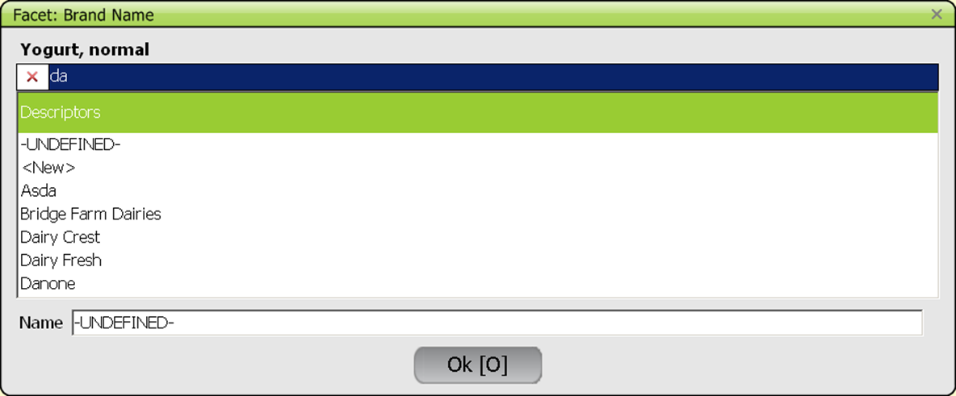
Description of Foods
Facet ‘Brand name’: a local pre-entered list exists.
Alphabetical (default) and string search are available.
During the interview, new product/brand name can be entered. It remains linked only to the on-going interview.
Interview steps
IARC, Lyon - France
GloboDiet training:

Slide 30
Description of Foods
Cooking method - important also! - used to calculate the final consumed quantity and linked to some variables (rawcook, pctfat, density, nutritional values).
There are
  groups of cooking methods to apply the raw-to-cooked coefficients and
  different groups of cooking methods to apply the % of fat absorbed.
Breaded/battered/in flour foods are treated as foods, not composed recipes, nor recipes.
Choice of the descriptor when several cooking methods have been used, e.g. fried aubergines, then baked, then reheated in a microwave oven:
  Choose the fattiest method (here fried) to assess fat absorption
If no fat used:
  Choose the driest method to assess the Extent of cooking
→ Be familiar with the descriptors (thesaurus)
Interview steps
IARC, Lyon - France
GloboDiet training:

Slide 31
Description - Links
N.B.: There are logical links between facets and descriptors
Examples:
Brand will not be asked for homemade items
→ foods prepared at home from commercial mixes (e.g. custards, cakes, breads, soups, sauces) by adding e.g. water should be described as ‘commercial’ to capture the brand
Extent of cooking will be asked only for certain cooking methods (when ‘roasted/baked, barbecued, fried, toasted, grilled’ or ‘n.s.’)
Flavours will be proposed only if descriptor ‘flavoured’ selected
Packaging material will not be asked if the answer to Packaging format is ‘no packaging’ – two step questioning
Type of fat used will be asked if e.g. ‘homemade, fat used known’
If ‘powdered’, the facet ‘Cooking method’ will not be asked…
We expect feed-back from the field to improve these rules.
Interview steps
IARC, Lyon - France
GloboDiet training:

Slide 32
Practise
Describe the quick list items ‘chicken with rice’ and ‘cake’
chicken, breaded and fried in sunflower oil (at home), without skin
white rice, boiled
sauce, tomato, brand Barilla
Cake, chocolate, homemade with butter and cream
Quantification: choose ‘?’ for this practise
GloboDiet training
IARC, Lyon - France

Slide 33
Quantification
Quantification concerns foods, recipe portions and ingredients if the recipe is known.
Only the consumed quantities must be entered if there are left-overs on the plate.
Depending on the item and its description, several quantification methods might be proposed (QMDETAIL)
Choose the one that suits the interviewee best: provide the picture number(s), show the shapes or HHM pictures to the interviewee
Check the dimensions whenever relevant
  Photos: show the size of the serving plate
  HHM: use the ruler to choose the correct (closer) one
    [note that a heaped spoon corresponds to 2 x volumes of spoon, the interviewee should enter what has been actually reported]
  Standard units STDU : use the ruler to decide if the unit is small, medium or large, based on the STDU comment
  Shapes and thicknesses
Interview steps
IARC, Lyon - France
GloboDiet training:

Slide 34
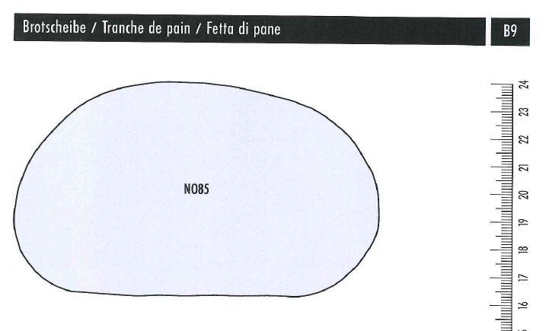
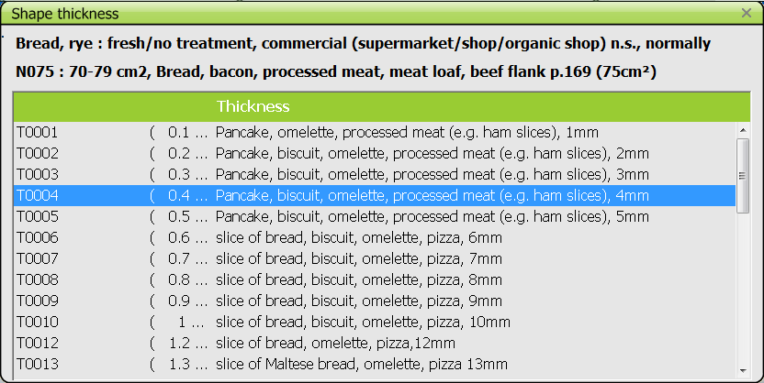
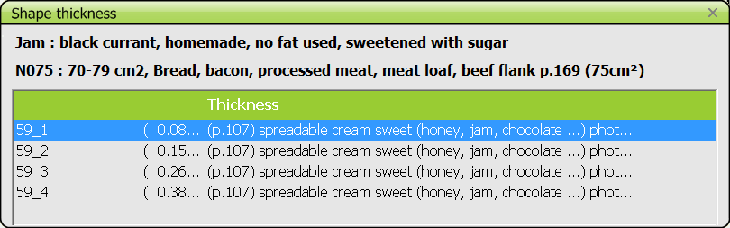
Quantification
The method ‘shape’ is a two step quantification procedure
Select the surface
Select the thickness of the bread or of the topping
For all methods
Possibility to choose a fraction or several units/serving
Interview steps
IARC, Lyon - France
GloboDiet training:

Slide 35
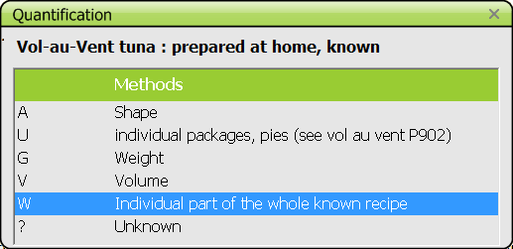
Quantification
Unknown quantities:
For known recipes, the portion may be a fraction (e.g.1/4) of the prepared recipe
Interview steps
IARC, Lyon - France
GloboDiet training:

Slide 36
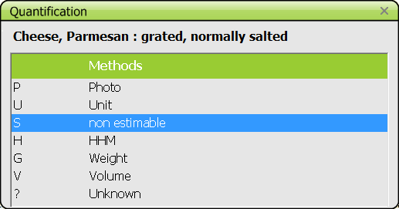
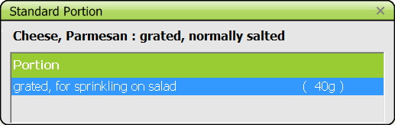
Quantification
Unknown quantities:
For known recipes, the portion may be a fraction (e.g.1/4) of the prepared recipe
For some foods – not recipes-, standard portions might have been foreseen (e.g. for grated cheese on pasta or salad) (FDSTD)
Interview steps
IARC, Lyon - France
GloboDiet training:

Slide 37
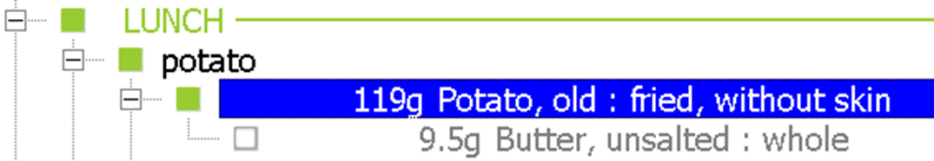
Quantification
Unknown quantities:
For known recipes, the portion may be a fraction (e.g.1/4) of the prepared recipe
For some foods – not recipes-, standard portions might have been foreseen (e.g. for grated cheese on pasta) (FDSTD)
The quantity of fat absorbed during cooking is calculated based on the food item and its cooking method (PCTFAT)
Interview steps
IARC, Lyon - France
GloboDiet training:

Slide 38
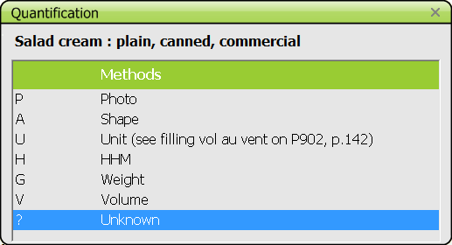
Quantification
Unknown quantities:
For known recipes, the portion may be a fraction (e.g.1/4) of the prepared recipe
For some foods – not recipes-, standard portions might have been foreseen (e.g. for grated cheese on pasta) (FDSTD)
The quantity of fat absorbed during cooking is calculated based on the food item and its cooking method (PCTFAT)
The quantities of fats, sauces and sweeteners added to foods and recipes can be calculated using standard coefficients (PCTFSS). The interviewer has to select the method ‘?’ and, on a specific screen, specify on what item(s) the addition was made
Interview steps
IARC, Lyon - France
GloboDiet training:

Slide 39
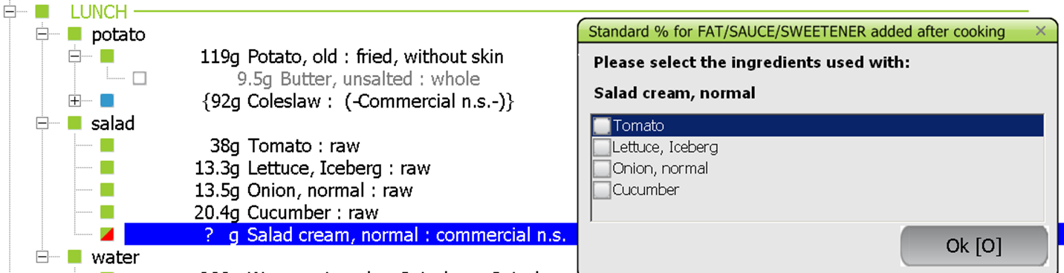
Quantification
The quantities of fats, sauces and sweeteners added to foods and recipes can be calculated using standard coefficients (PCTFSS). The interviewer has to select the method ‘?’ and, on a specific screen, specify on what item(s) the addition was made
Interview steps
IARC, Lyon - France
GloboDiet training:

Slide 40
Quantification
Unknown quantities:
For known recipes, the portion may be a fraction (e.g.1/4) of the prepared recipe
For some foods – not recipes-, standard portions might have been foreseen (e.g. for grated cheese on pasta) (FDSTD)
The quantity of fat absorbed during cooking is calculated based on the food item and its cooking method (PCTFAT)
The quantities of fats, sauces and sweeteners added to foods and recipes can be calculated using standard coefficients (PCTFSS). The interviewer has to select the method ‘?’ and, on a specific screen, specify on what item(s) the addition was made
Select the method ‘?’ and enter notes to be able to update the interview data afterwards
Interview steps
IARC, Lyon - France
GloboDiet training:

Slide 41
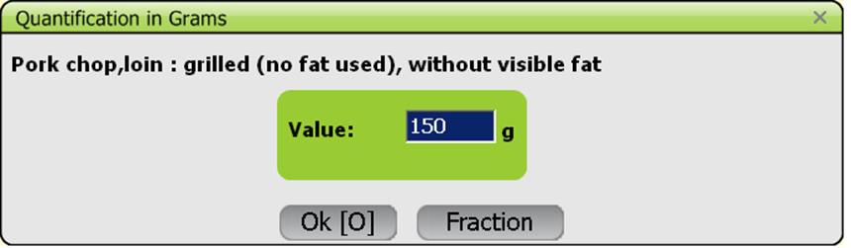
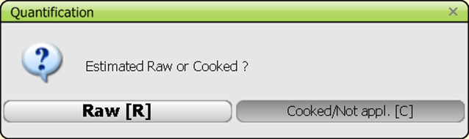
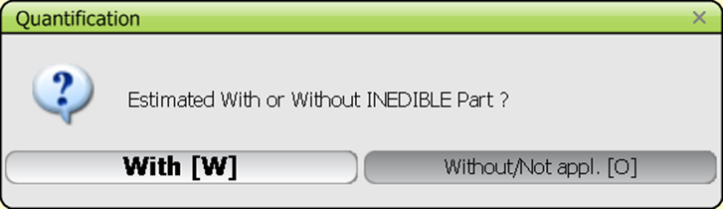
Quantification
If the food/ingredient is described as ‘cooked’ or ‘n/a’
If estimated ‘raw’ and described as ‘cooked or not applicable’ then a raw-to-cooked coefficient linked to the cooking method is applied
If the food/ingredient has an edible part coefficient
If estimated ‘with waste’ then an edible part coefficient will be applied. This may depend on the description e.g. skin consumed or not.
Interview steps
IARC, Lyon - France
GloboDiet training:

Slide 42
Practise
Quantify the described items (choose ‘modify quantity’)
chicken, breaded and fried in sunflower oil (at home), without skin with a photo
white rice, boiled – half a glass of raw rice (HHM)
sauce, tomato, brand Barilla – unknown- added to the rice
Cake, chocolate, homemade with butter and cream – 1/8 of cake diameter 24cm, 2cm thick (method shape)
GloboDiet training
IARC, Lyon - France

Slide 43
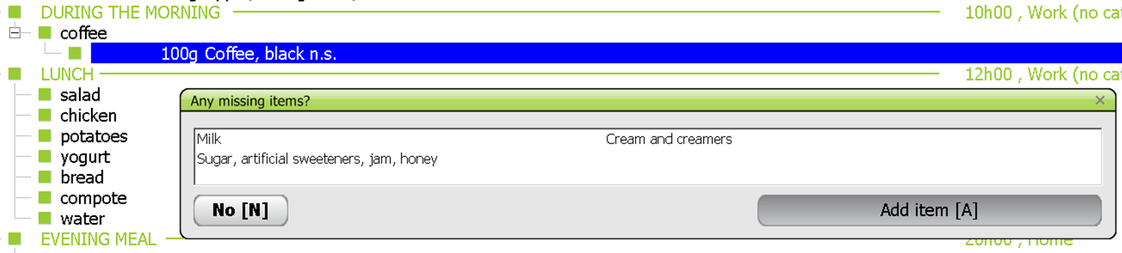
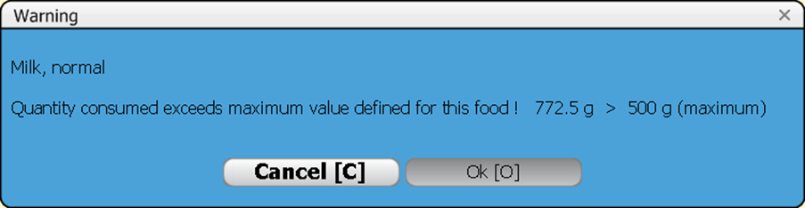
Description & Quantification: controls
Controls during this step:
Probing questions on foods and recipes to check the completeness of the item list (reflect local consumption habits)
→ Anything else with it? (neutral question)
‘Exceeding values’
Warning only
Interview steps
IARC, Lyon - France
GloboDiet training:
Notes:
Remark from the Netherlands: probings should be as neutral as possible. Therefore it is recommended to choose for general probing items (e.g. Sandwich filling instead of jam, honey, etc.
However, this should be adapted in EPIC-Soft rather so that the interview can always read what appears on the screen.

Slide 44
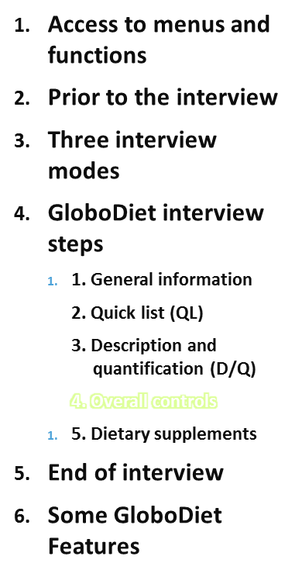
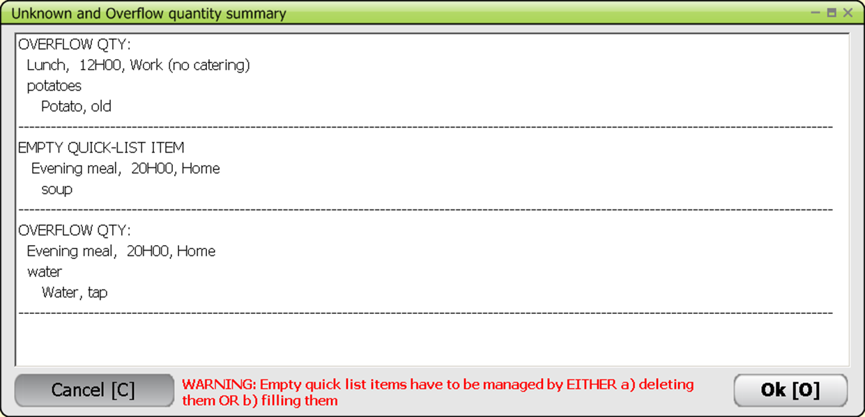
Before ending the interview, the UNKNOWN AND OVERFLOW QUANTITY SUMMARY screen listing the empty QLI and foods/recipes with missing (or overflow) quantities is displayed.
It is based on automatic notes created by the software.
Interview steps
IARC, Lyon - France
GloboDiet training:

Slide 45
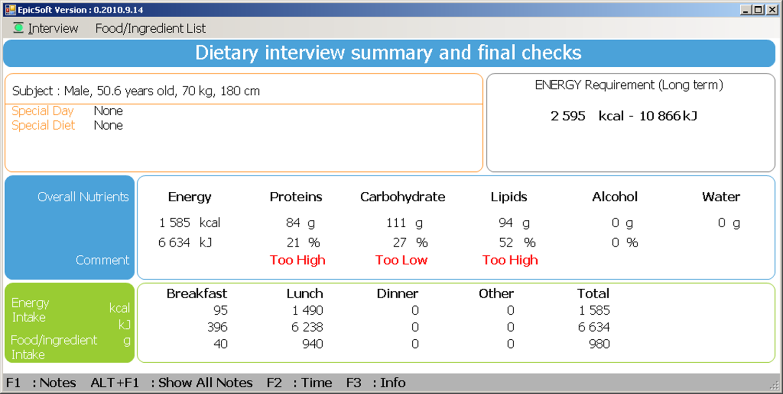
Overall Controls
Interview steps
IARC, Lyon - France
GloboDiet training:

Slide 46

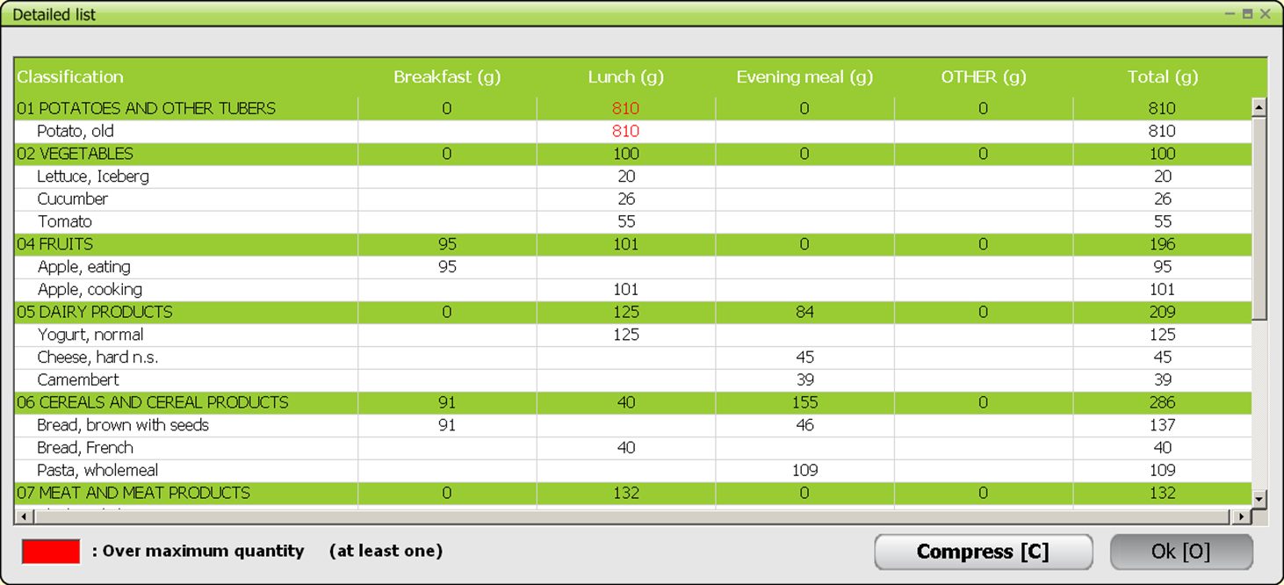
Overall Controls
Interview steps
IARC, Lyon - France
GloboDiet training:

Slide 47
Practise
Select ‘interview- next interview step’
See all the automatic notes in the UNKNOWN AND OVERFLOW QUANTITY SUMMARY
See the warnings in the Dietary interview summary and final checks – expand and compress the list of items
GloboDiet training
IARC, Lyon - France

Slide 48
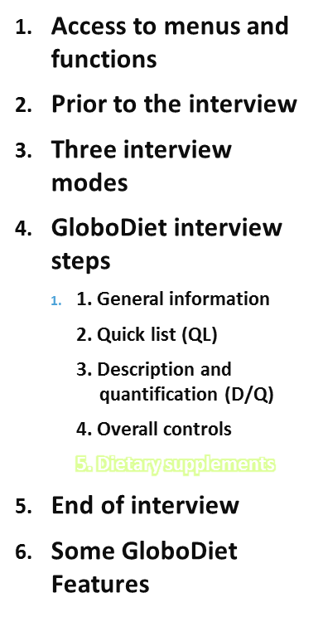
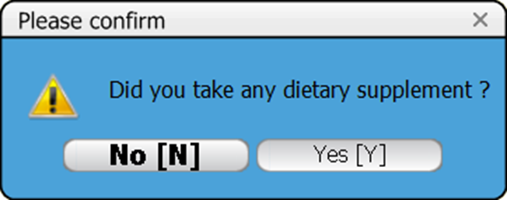
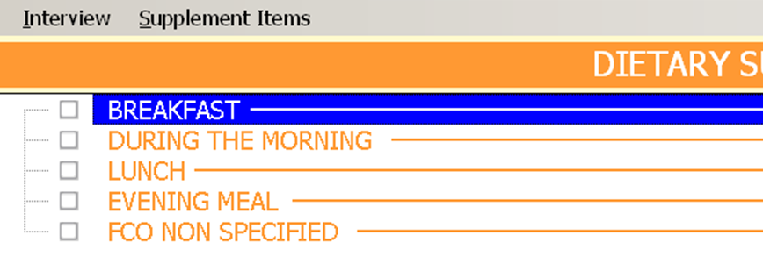
At the end of the interview, the information about the vitamins or other supplements (or any medication containing vitamins, minerals...) that have been consumed will have to be completed.
They can be linked to existing FCOs or to additional FCOs or an unspecified FCO.
Interview steps
IARC, Lyon - France
GloboDiet training:

Slide 49
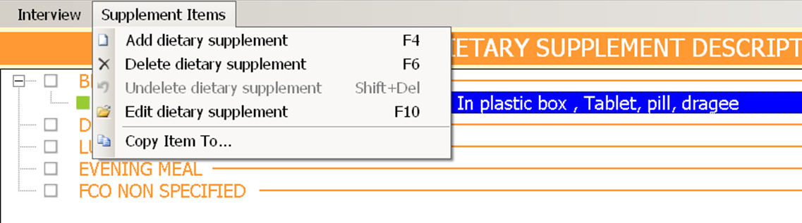
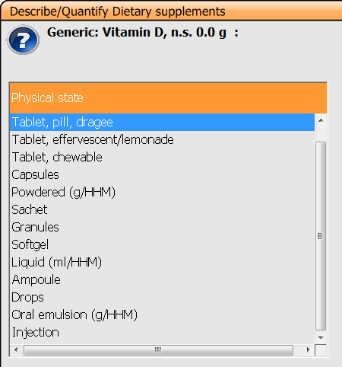
Dietary Supplements
Search in the list (specific and generic items (GI))
  Alphabetical
  Search for a string
  New → notes
Describe with facets
Quantify as - number of units
- of g
- of ml
- HHM (same list as foods and recipes)
- unknown
Interview steps
IARC, Lyon - France
GloboDiet training:

Slide 50
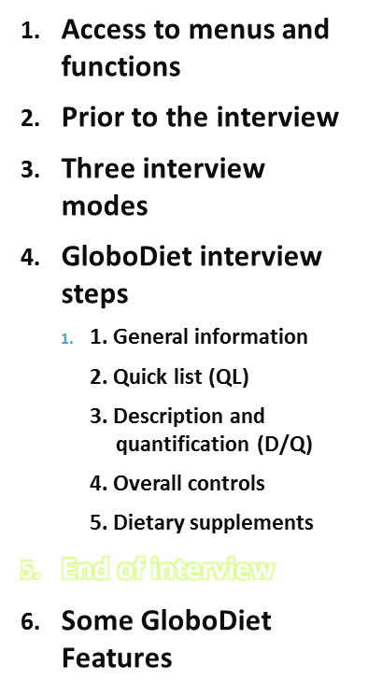
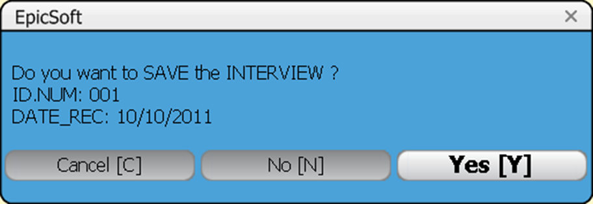
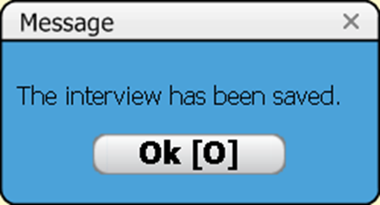
And save the interview!
End the interview
Interview steps
IARC, Lyon - France
GloboDiet training:

Slide 51
Practise
Confirm the interviewee had a dietary supplement
Select food consumption occasion ‘before breakfast’
Enter one effervescent tablet of vitamin C
Save the interview
GloboDiet training
IARC, Lyon - France

Slide 52
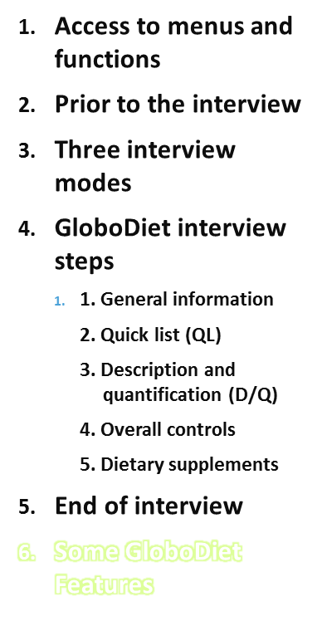
1. Assessment of fats, sauces and sweeteners
  Foods cooked with fat are split into food + fat.
  Fats, sauces and sweeteners are not listed in the Quick list. They are linked to other food(s) & can be quantified using standard coefficients.
2. Qualitative information on fat used and/or on milk/liquid used
  For complex foods (e.g. sauces, cakes, biscuits), the facets ‘Type of fat used’ and/or ‘Type of milk/liquid used’ may be asked to capture the fat(s) and/or liquid (s) used during preparation
Interview steps
IARC, Lyon - France
GloboDiet training:

Slide 53

1- Assessment of fats, sauces and sweeteners
Foods cooked with fat are split into food + fat. The amount of fat absorbed during cooking is calculated by GloboDiet
  PCTFAT coefficients
  Nutritional values of e.g. ‘fried potatoes’ are without cooking fat
Interview steps
IARC, Lyon - France
GloboDiet training:

Slide 54

1- Assessment of fats, sauces and sweeteners
Fats, sauces and sweeteners are not listed in the Quick list. They are linked to other food(s). If their quantity is unknown (‘?’) then it can be calculated using standard coefficients.
→ PCTFSS (fat, sauce, sweetener) standard coefficients
For fats and sauces, GloboDiet may automatically ask whether there was some fat/sauce left in the dish (local setting).
→ PCTFATLEFT coefficients.
Interview steps
IARC, Lyon - France
GloboDiet training:

Slide 55
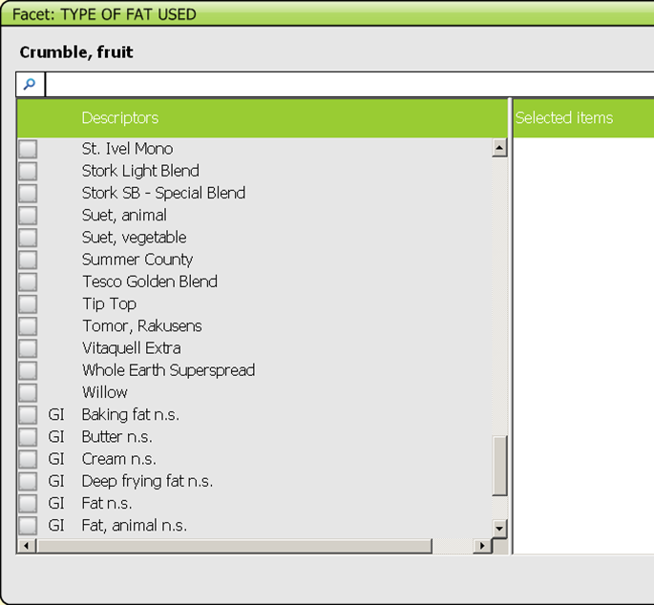
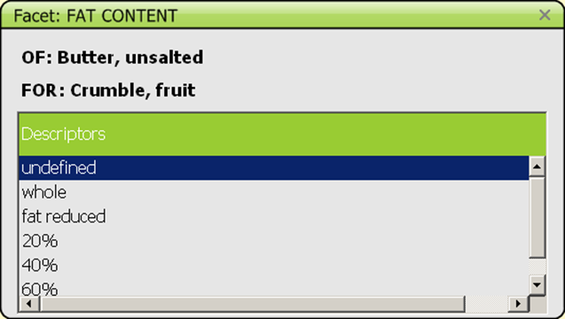
2- Qualitative information for complex foods
For complex foods (e.g. sauces, cakes, biscuits), the facets ‘Type of fat used’ and/or ‘Type of milk/liquid used’ may be asked to capture the fat(s) and/or liquid (s) used during preparation (e.g. cake home made with butter and margarine A.)
Country-specific fats and creams can be selected (multiple choice). Generic items are listed at the bottom of the list.
Selected fats are further described, like regular foods, using facets.
Interview steps
IARC, Lyon - France
GloboDiet training:

Slide 56
Remark for the trainers
Be aware that the examples given in this presentation might not necessarily correspond to the final GloboDiet version used in your study
Therefore it is important to adapt the print screens and/or examples according to your final GloboDiet version and Thesaurus!
Interview steps
IARC, Lyon - France
GloboDiet training:

